Slide 1
EXOPLANETS AND THE SEARCH FOR LIFE
By Sammarth Kumar

Slide 2
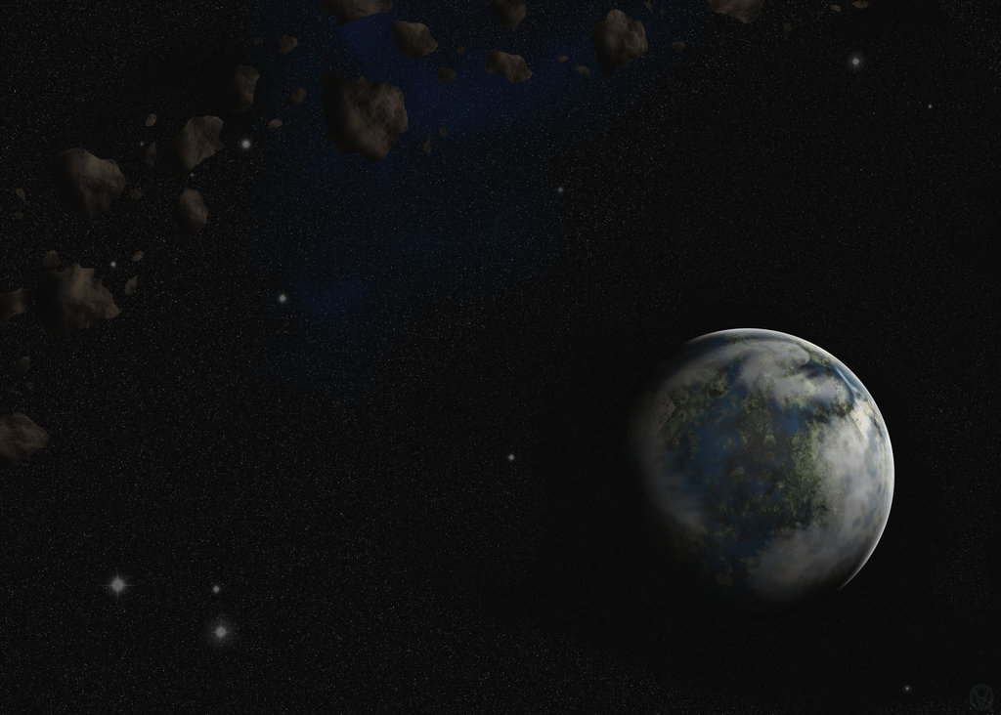
OVERVIEW
Exoplanets are bodies beyond our solar system which revolve around a star
Their study has become very popular nowadays with advancement in technology
Scientists and others are intrigued by the possibility of life on other planets

Slide 3
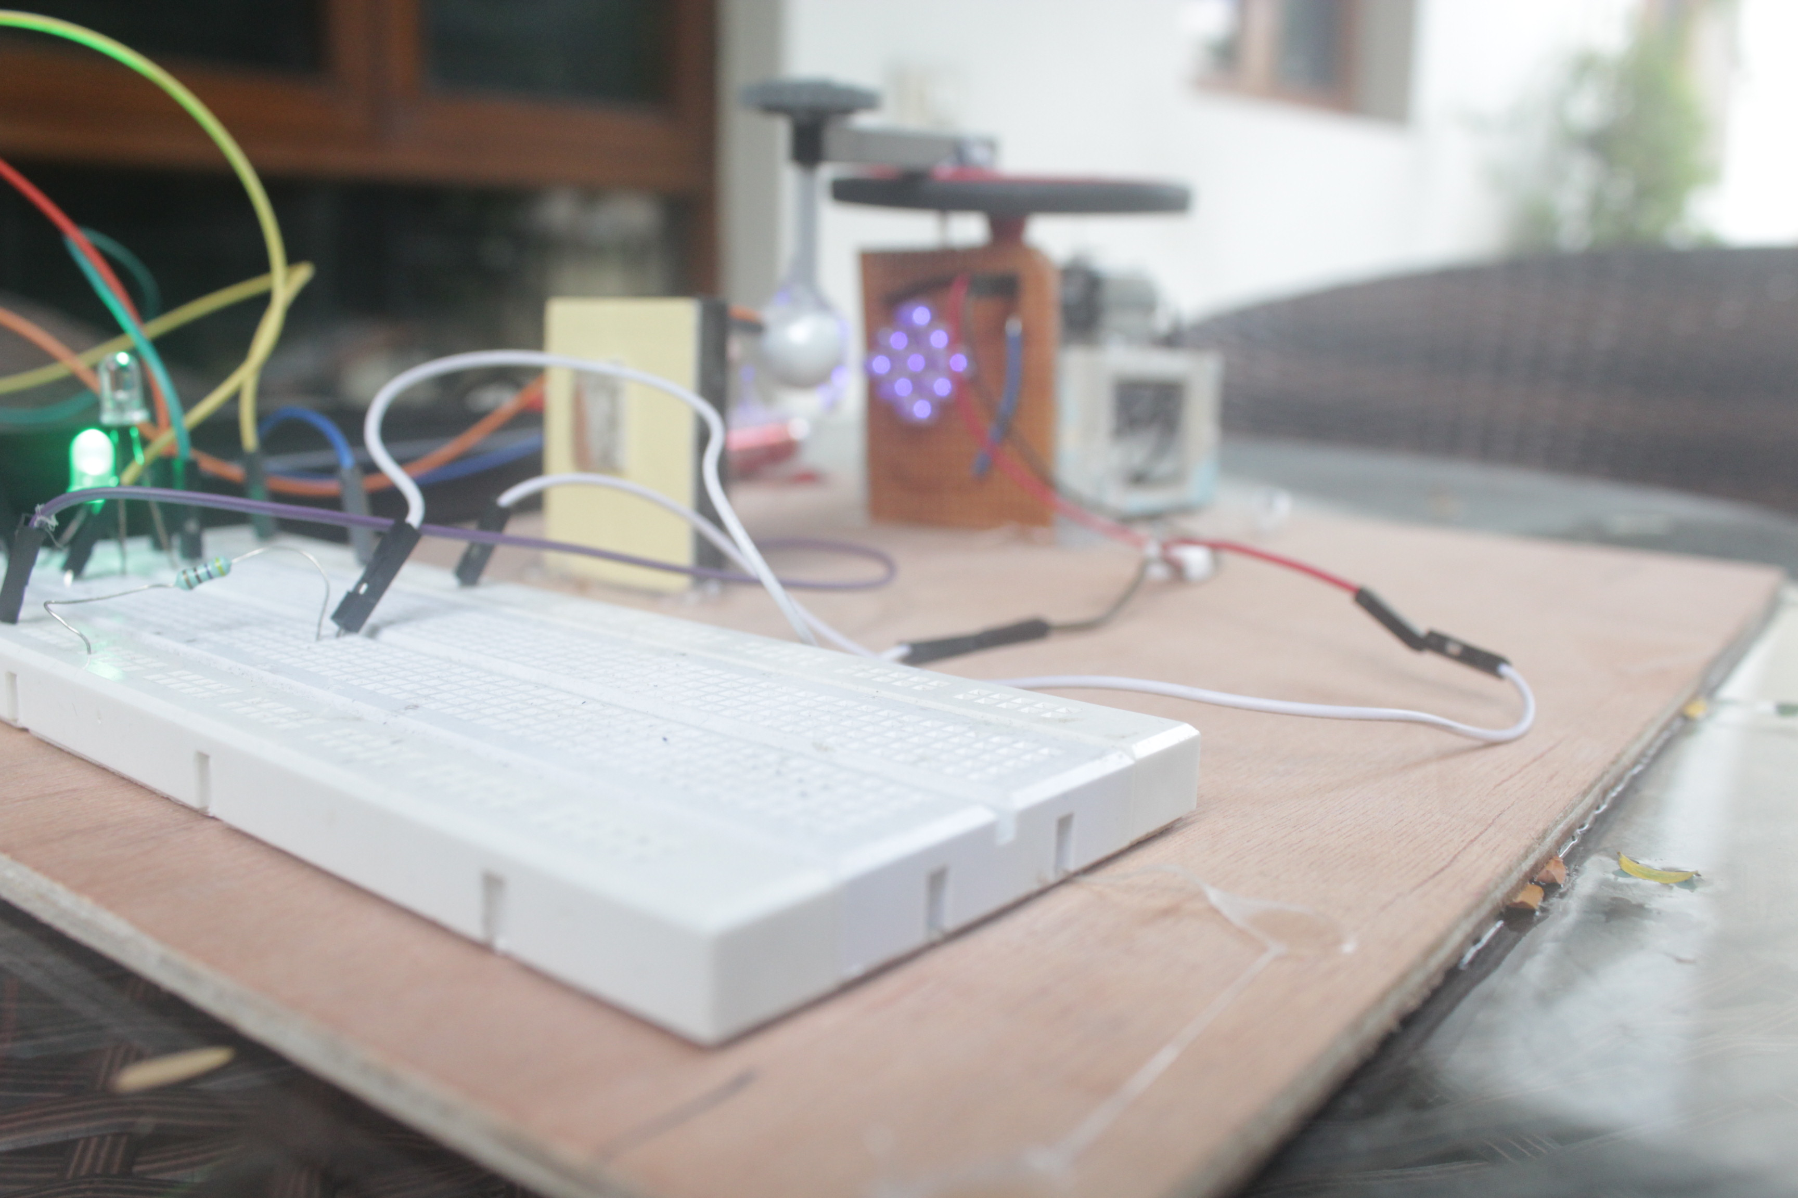
How do we detect one?
To demonstrate this, I have created my own Exoplanet Simulator which we will look at in a short while.

Slide 4
Life on other planets?
It is certainly possible that we aren’t the only living creatures in space.
NASA plans to send humans to Mars by 2024, the dragonfly mission to Titan is in the making and many such other programs are developing to extend the reaches of human civilization
The reason for life on Earth is a result of many factors and it would take some time to explain
The brief idea is that we are situated at a perfect distance from our star, the Sun and hence the surface temperature is neither too hot nor too cold. That is, we are in the Goldilocks Zone

Slide 5
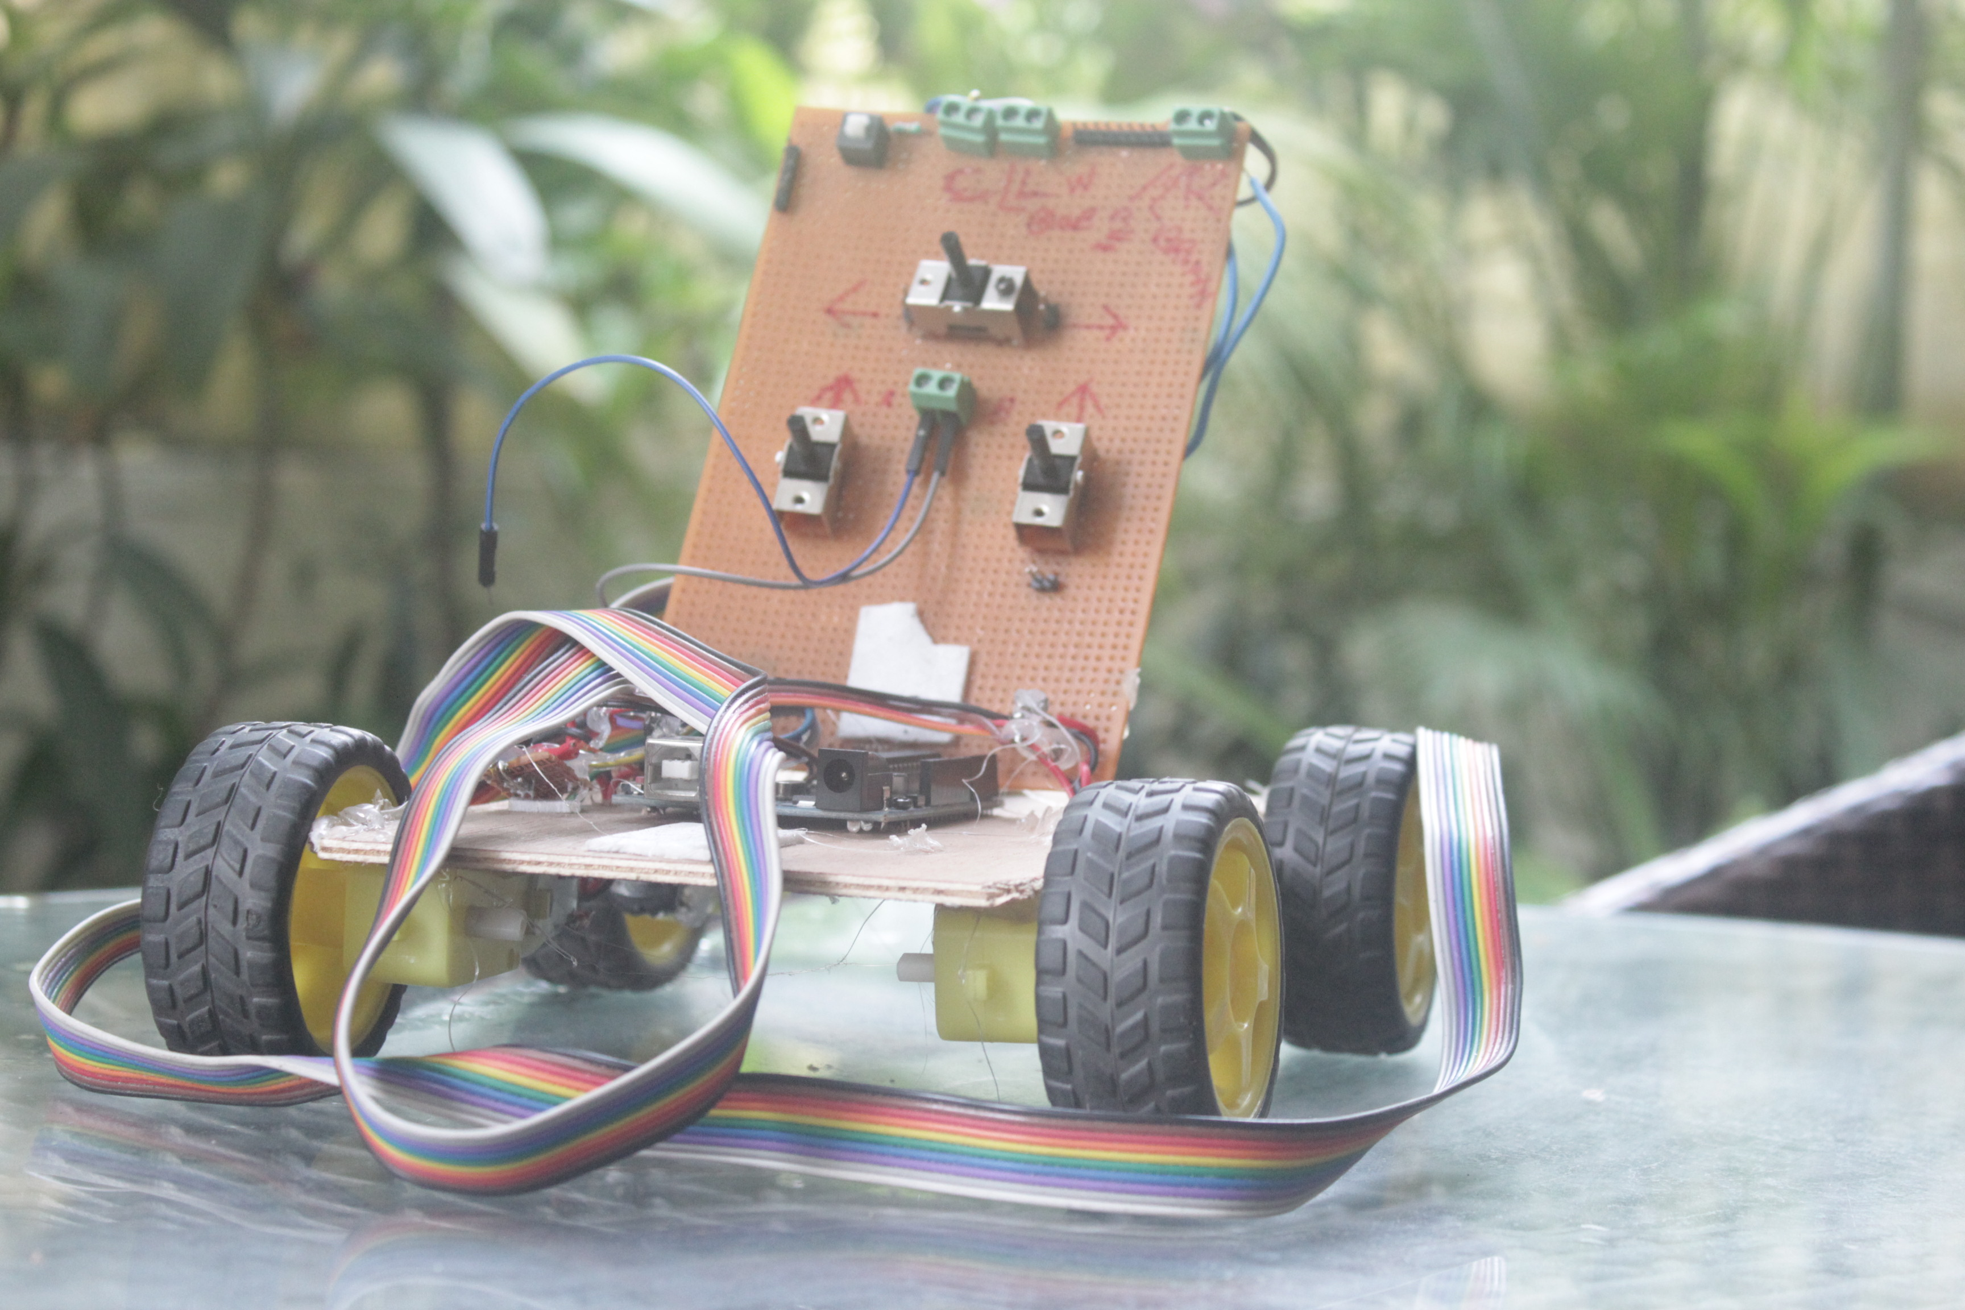
ExoRover
As an element of fun, I have built a small rover which we will put in action shortly.
The phone mounted feeds live video to the projector which will allow us to see what it sees, as in the Mars Rover.

Slide 6
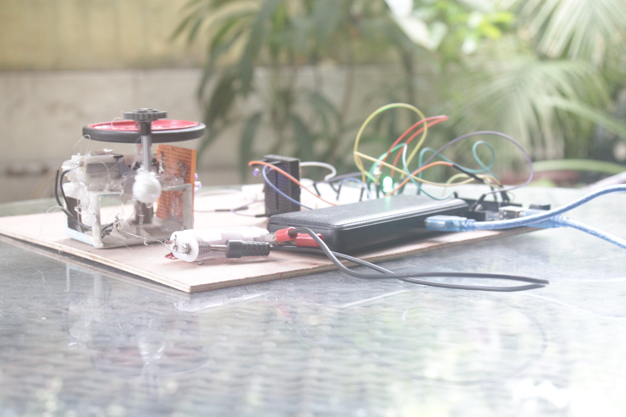
Exoplanet Simulator
This is my very own invention in which I’ve built a mechanical model and written its algorithm from scratch
It consists of a planet orbiting a star
The algorithm measures time periods between dips in brightness readings and determines whether the object is an exoplanet or not

